Slide 1
App Teximeter
Security

Slide 2


Classic Teximeter
Computing Fare
From Wheel Spinning
1000
1100
1200
1300

Slide 3

New Teximeter
Computing Fare
From GPS Location
1000
1100
1200
1300

Slide 4
Classic VS New
 | Classic | New
Form | Hardware | Software
Computing Fare | Wheel Spinning | GPS
Traits | Exact Computing Update Problem | Detailed Receipt Remote Pay Hacking*

Slide 5
Cons
Network Communication
Tunnel
Error Rate
GPS
Security

Slide 6
How to Compute Exactly
Location

Slide 7




Location Attestation (1:2)
Bluetooth
MATCH
Driver
Customer

Slide 8






Location Attestation (1:N)
Bluetooth
MATCH
Traffic Light
(Infra)
Other Driver
Pedestrians

Slide 9

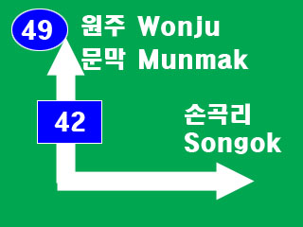


Location Attestation (Blackbox, Blockchain)
Path (Busan to Seoul)
(Daegu, 70)
(Daegu, 35)
(Seoul, 120)
(Seoul, 60)
(Seoul, 10)
Daegu 70Km
Daegu 35Km
Seoul 120Km
Seoul 60Km
Seoul 10Km

Slide 10
How to Compute Exactly
Fare

Slide 11
Record Case In Blockchain
Origin | Destination | Extra Charge | Fare
A | B | NO | 20$
A | B | YES | 25$
A | B | YES | 23.2$
A | B | YES | 27$
… | … | … | …
… | … | … | …
… | … | … | …
MATCH
My Case
A | B | YES | 25$

